Slide 1

Node JS
Specialization
.Net Core, ASP.Net Core, ASP.Net Core MVC, Micro services
C# 7.0 and White Framework
WCF 4.5.1, Web API, WF 4.5.1
RPA with Blueprism
Prism 5 with MEF & MVVM
Cloud Computing (Azure)
UML 2 and OOAD
HTML 5, CSS 3, SASS
65 .Net Design Patterns
JavaScript, Jquery 2.x , Bootstrap
Ext JS 6, TypeScript, Angular 5.0, Ember ,React , Redux , Backbone, D3, Three.js
Kendo UI, D3.js,Coffee script
Node JS, Dust , Hapi ,Mongo
Software Architecture
Mocha, QUnit, Jasmine,Karma
Grunt,gulp, Webpack
D.S.R.Murthy M.Tech (IT)
Software Architect & Corporate Trainer
Experience : 28 years

Slide 2
Problems faced by Architects
How to serve many thousands of simultaneous clients efficiently & concurrently without sacrificing performance and reliability.
How to work with real time data over internet
Scaling networked applications beyond a single server
Preventing I/O operations from becoming bottlenecks
Eliminating single points of failure, thereby ensuring reliability.
Achieving parallelism safely and predictably
How to handle authentication (form/passport) with Cross site scripting attack.

Slide 3
Solution - Node JS
Node.js was created by Ryan Dahl in 2009
Official definition:
“A platform built on Chrome’s JavaScript runtime for easily building fast, scalable network applications with event-driven, non-blocking I/O model that makes it lightweight and efficient, perfect for data-intensive real-time (DIRT ) applications that run across distributed devices.”
Node.js = Runtime Environment + JavaScript Library

Slide 4
Solution - Node JS
Node provides a fast, scalable, reliable, extensible, lightweight, purely event-driven, non-blocking infrastructure for building highly concurrent software with server side java script executed on V8 Google engine for building network based applications to handle real time data supported on Windows, Linux, Macintosh, and Solaris platforms.
Single Threaded & concurrent model
Node runtime now supports ECMA6 / Harmony

Slide 5
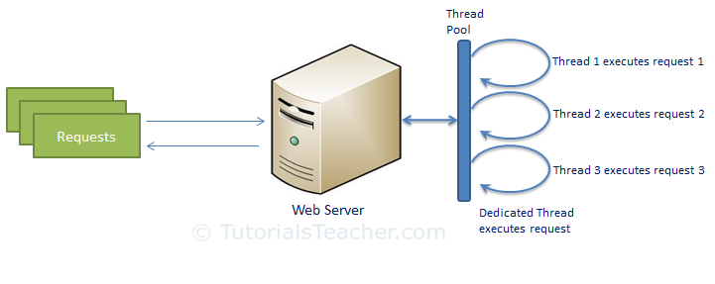
Traditional Web sever model

Slide 6
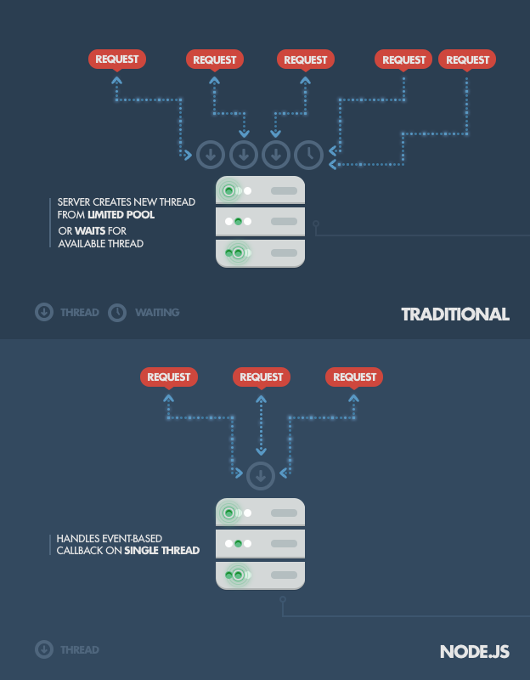
Node JS vs Traditional web server
Each thread consumes 2MB RAM
And context switch is costly

Slide 7
Why node js?
A quick calculation:
Assuming that each thread potentially has an accompanying 2 MB of memory with it, running on a system with 8 GB of RAM puts us at a theoretical maximum of 4000 concurrent connections, plus the cost of context-switching between threads.
By avoiding all that, Node.js achieves scalability levels of over 1M concurrent connections (as a proof-of-concept).
Target : C10K/C1M/C5M/C100M

Slide 8
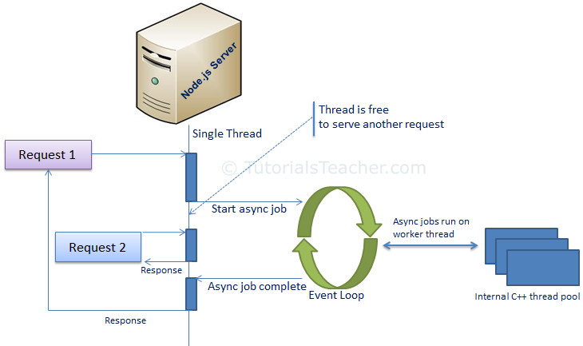
How node works
Uses libev C++ library for event loop

Slide 9
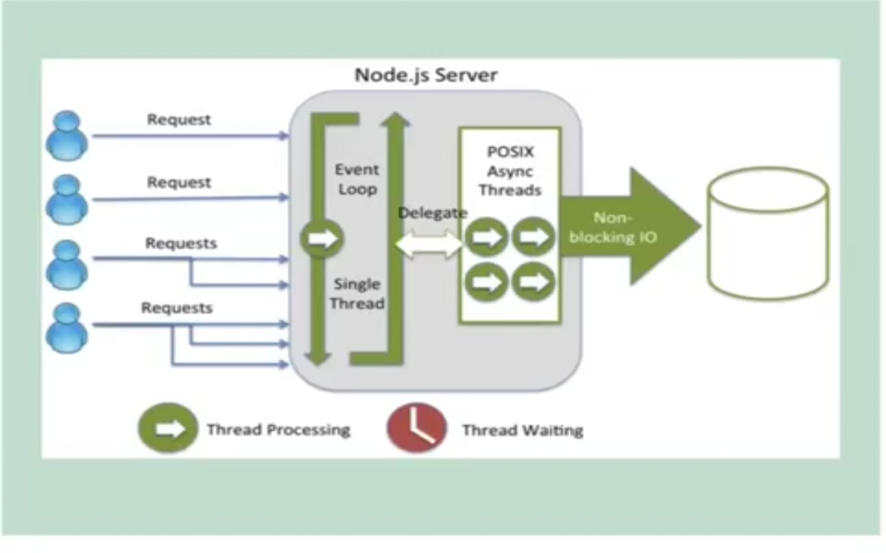
Event Loop
Node uses observer pattern.
Node thread keeps an event loop and whenever any task get completed, it fires the corresponding event which signals the event listener function to get executed.
libio
libev

Slide 10
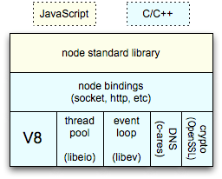
Background Architecture
Window global object in browser = globals in node js
Document object in browser= process in node js
Notes:
Web browser manages a single thread to run the entire JavaScript code using an inner loop a.k.a the event loop, which is basically a single-threaded loop that the browser runs infinitely. When some event gets emitted, the browser adds it to its event queue. The event loop then grabs the next event from the event queue in order to execute the event handlers registered to that event. After all of the event handlers are executed, the loop grabs the next event from the queue, executes its handlers, grabs the next event from the queue, and you get the picture

Slide 11
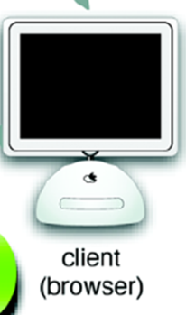
Node js
M
I
D
D
L E
W
A
R
E
Web Server
http/express/connect
AJAX
Jade/EJS underscore/Lodash
MVC
Routing
Clustering / Monitoring
REST
CRUD
Mongo DB,
MySql,
CouchDB
DAL
Mongo
Mongoose
…….
fs
net
Web socket
Sql Server,
Oracle
……
Core modules
Test
Events
npm grunt gulp
OS
Plugin’s (C/C++)
http/tcp/udp
Node Runtime
libuv libio

Slide 12
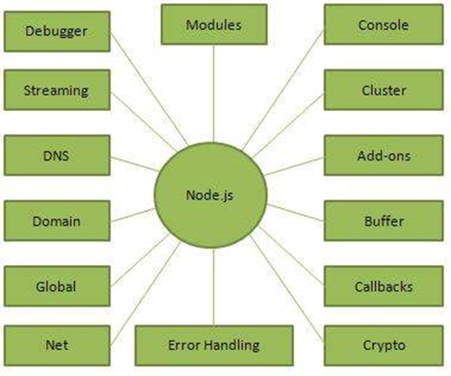
Node modules (API)
Notes:
Node introduced the concept of the package, following the CommonJS specification. (NPM)
A package is a collection of program files bundled with a manifest file describing the collection.
Dependencies, authorship, purpose, structure, and other important meta-data are exposed in a standard way.

Slide 13


Architecture (Angular vs Node)
Java Script (Node)
Jade /EJS templates
REST with Express
HTML + Java Script + CSS
Google Chrome V8 JS engine
‘node Connect’
Middleware
http (s)
server
HTTP (s) / UDP / Sockets
Web
socket
MongoDB
Mysql
Sql server
Node JS
Google V8 java script Engine
Angular JS
Ext JS
Backbone JS
Jquery
React JS /FLUX
Node.tap/Mocha for testing
Node Inspector for debugging
Js Lint for Code Analysis
Grunt / Gulp for building/Testing
Jxcore for packaging

Slide 14
Node JS users
Microsoft, Yahoo, Uber, and Walmart completely moving their server-side operations to Node.js
Real time apps - PayPal, eBay, and Groupon
Node JS Documentation :
https://nodejs.org/api/

Slide 15
Installing Node

Slide 16
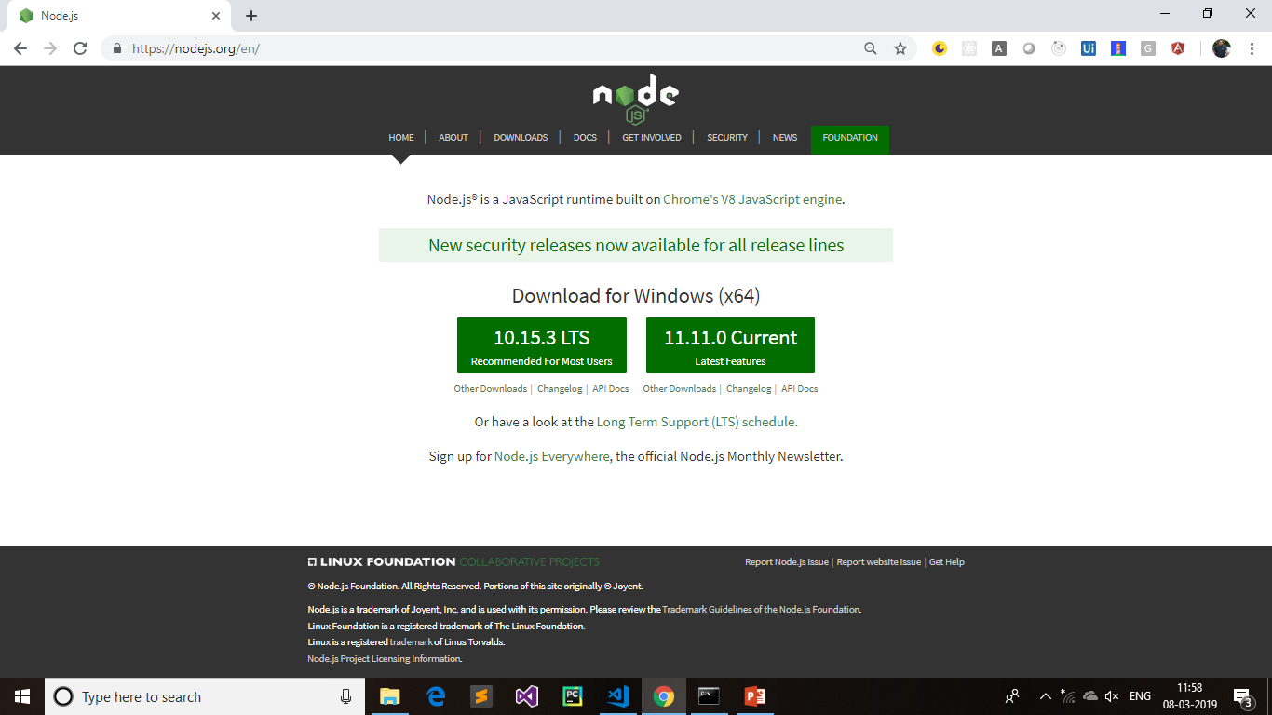

Slide 17
Editors
Sublime Text 3.0
Visual Studio Code
Jet Brains
Aptana Studio
Eclipse
Visual Studio 2013/2015/VS 2017
Notepad++

Slide 18
Node basics
' }
Primitive Types:
String
Number
Boolean
Undefined
Null
RegExp
Everything else is an object in Node.js.
var obj = {
authorName: ‘Murthy',
language: 'Node.js
}

Slide 19
Node basics
' }
Process object:
Each Node.js script runs in a process.
It includes process object to get all the information about the current process of Node.js application.
> process.execPath 'C:\\Program Files\\nodejs\\node.exe' > process.pid 1652 > process.cwd() 'C:\\

Slide 20
Node basics
' }
Access Global Scope:
In a browser, global scope is the window object.
In Node.js, global object represents the global scope.
global.company=‘Murthy Infotek’

Slide 21
Node Modules
' }
Module in Node.js is a simple or complex functionality organized in single or multiple JavaScript files which can be reused throughout the Node.js application.
Each module in Node.js has its own context, so it cannot interfere with other modules or pollute global scope.
Node.js implements CommonJS modules standard.
Module Types:
Core Modules
Local Modules
Third Party Modules

Slide 22
Node Modules
' }
These core modules are compiled into its binary distribution and load automatically when Node.js process starts.
Loading module : var module = require('module_name');
Core Module | Description
http | http module includes classes, methods and events to create Node.js http server.
url | url module includes methods for URL resolution and parsing.
querystring | querystring module includes methods to deal with query string.
path | path module includes methods to deal with file paths.
fs | fs module includes classes, methods, and events to work with file I/O.
util | util module includes utility functions useful for programmers.

Slide 23
Using the Global versus the Local Mode
npm has two main modes of operation: global and local.
> npm install <package name>
Download all resources in node_modules folder
The global mode is suited for installing modules that should always be available globally, like command-line utilities
>npm install -g mongodb (g=global)
>npm uninstall –g mongodb
>npm install express
> npm update express
> npm search express
NVM (Node version manager) :
> npm install nvm
> nvm install v0.10.31
> nvm use v0.8.10
node –v
nvm list

Slide 24
Publishing modules
First : npm init ( answer all questions)
// testmodule.js
var _getType = function () {
return 'CommonJS Module private Function';
};
module.exports.describe = function () {
return 'I am a CommonJS Module with Private function :'+_getType();
};
// check.js
var testModule = require('./testmodule.js');
console.log(testModule.describe());

Slide 25
Package.json
Package.json > npm init
This file defines some metadata such as the project name and version, some scripts, the package dependencies.
name is the name of the project.
version is the current version of the project.
author - author of the package
description - description of the package
dependencies is a list containing the Node.js modules used by your application.
repository - repository type and url of the package
main - entry point of the package

Slide 26
Package.json
> npm adduser
Username: murthy
Password:
Email: (this IS public) murthy@gmail.com
> npm publish
If everything is fine with your module, then it will be published in the repository and will be accessible to install using npm like any other other Node.js module
> npm install sriapp@1.0.0
Observe node_modules folder and your files here.

Slide 27
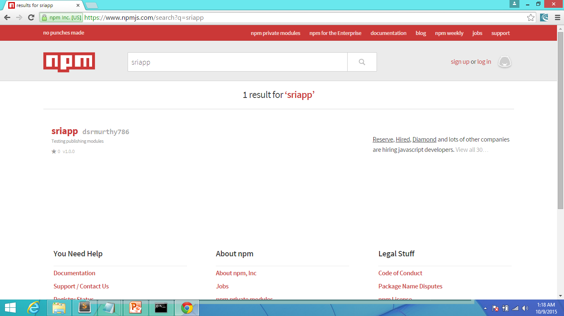
Package.json

Slide 28
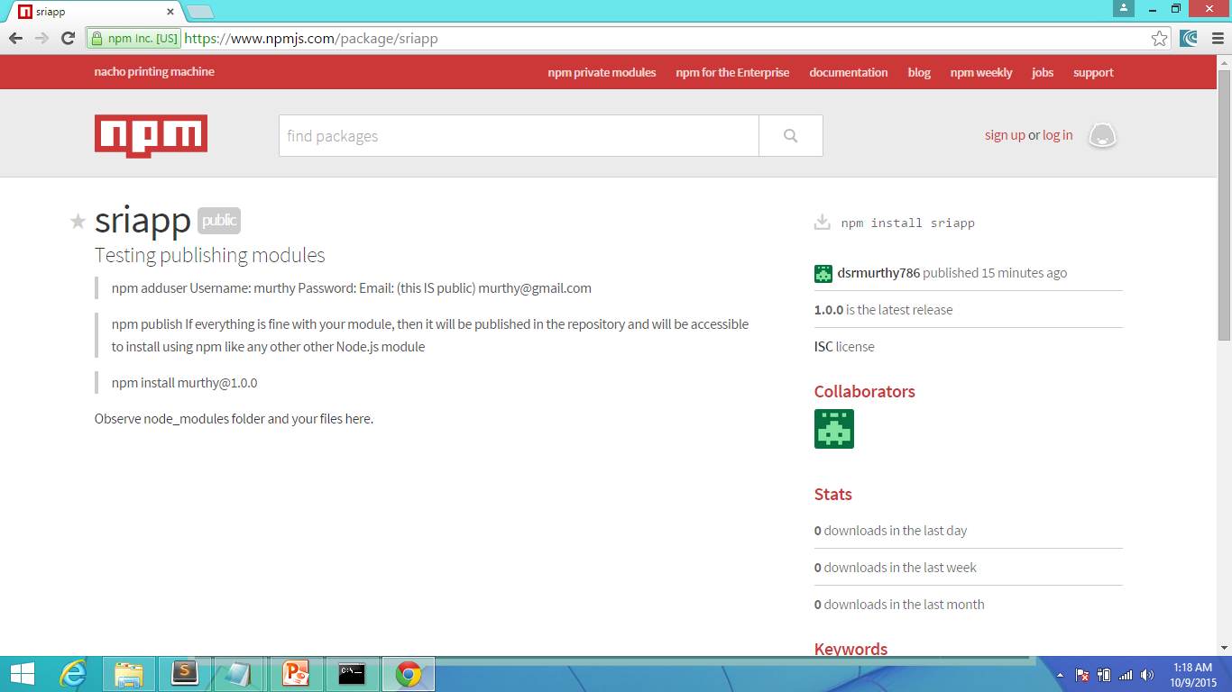
Package.json

